Slide 1
Step
Door
Project
Status Update
May 31, 2000

Slide 2
Table of Contents
Background
Goals and Objectives
Remote Locations Targeted/Status Update
Common Observations
Next Steps

Slide 3
Background
Market conditions in domestic United States and certain international locations are conducive to opportunities for Enron to participate in commodity arenas and benefit from increasing demands in energy needs.
As a result, remote origination, marketing and trading offices are being established in locations with positive indicators toward market expansion and increasing revenue potential.
Management has undertaken an effort to assure the internal control environment surrounding establishment and management of the remote office locations and whether the office infrastructure will provide reliable financial information and properly safeguard company assets.

Slide 4
Goals and Objectives
Objectives/Scope of Review
Perform an on-site review of processes, procedures and operational controls that support business activities related to trading and transaction origination within the remote location. Procedures include:
Interviews with key commercial, energy operations and accounting personnel
Perform a test of commodity transactions from deal execution through financial settlement
Team Resources
Integrated “SWAT” team with designated Enron project lead, accompanied by other Enron and Arthur Andersen core team members from Houston and London.

Slide 5
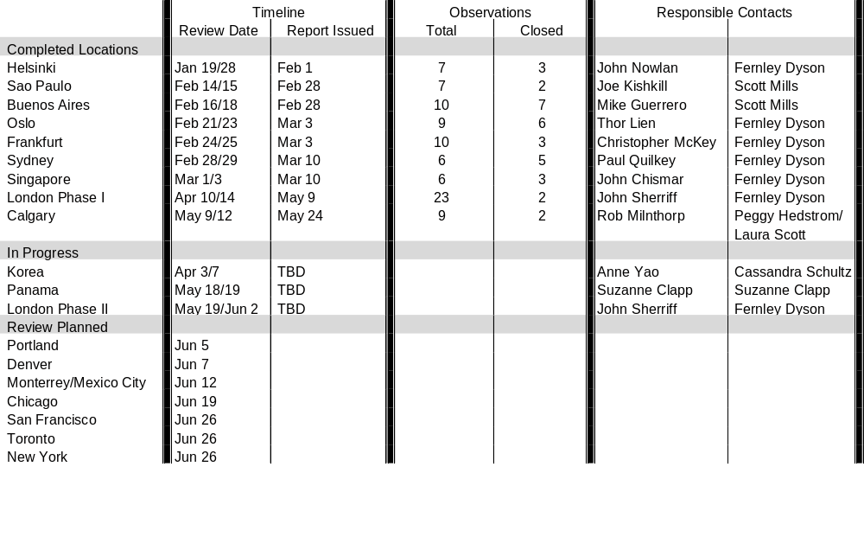
Locations Targeted/Status Update
Project Doorstep Reviews - 2000

Slide 6
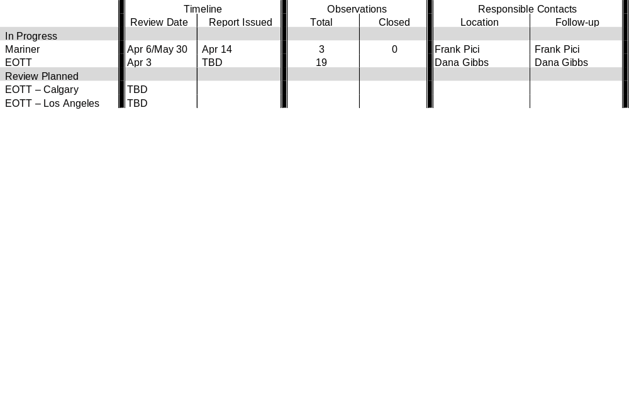
Affiliate Locations Targeted/Status Update
Project Doorstep Reviews - 2000

Slide 7
Common Observations
Minimum standards or requirements for establishment of remote origination, marketing or trading offices for personnel, processing, reporting and/or automated system support have not been developed.
Traders perform other functions such as logistics or confirmation of deal terms, which are incompatible duties per the Enron Risk Management Policy. (SI, SD, CA)
Individual transactions or components of complex deals were incorrectly captured or not captured in a risk book and overall position totals. (BA, CA, SI, SP)
Foreign currency exposure for remote offices is centrally managed; however, totals are not included in the overall FX position aggregation and limit monitoring. (CA)
Valuation, Pricing and forecasting models have not been validated by an individual independent of the traders or structuring group. (SP, OS, LO)
Key
SI - Singapore OS - Oslo
SD - Sydney LO - London
SP - Sao Paulo FR - Frankfurt
BA - Buenos Aires CA - Calgary

Slide 8
Common Observations (cont.)
Confirmation process centralized in Houston for certain remote locations results in delays in processing documentation and ineffective follow-up procedures. (SD, CA)
Telephone lines for office, home, and cellular units used to conduct transactions are not recorded. (SI, SP, LO)
Documentation of credit approval not available for deals executed. (BA, OS)
Static and transactional data can be accessed by individuals without a business need. (BA, FR, OS)
Contracts in foreign language are not consistently translated into certified English versions. (BA, SP, FR)
Key
SI - Singapore OS - Oslo
SD - Sydney LO - London
SP - Sao Paulo FR - Frankfurt
BA - Buenos Aires CA - Calgary

Slide 9
Next Steps
Near Term
Finalize in-progress reviews and schedule and staff Enron/AA teams for remaining domestic and international locations.
Prioritize previously identified observations and determine realistic process “fixes” and completion deadlines.
Revise 2000 business audit plan to incorporate impact of review procedures performed on scheduled remote locations.
Re-clarify definition of origination, marketing or trading business activities and develop minimum standards or “best practices” for operations of each (including people, processes and automated systems).

Slide 10
Next Steps (cont.)
Subsequent Reporting Periods
“Institutionalize” reviews of remote locations.
  Selection of locations
  Scope of review
  Composition of learn
Determine process and business owner.
Re-assess minimum standards based on a “years review of remote locations”.

